Slide 1
Campout Q&A
9/22/25

Slide 2
Aske Questions At Any Time!
Camp will begin at 9am Saturday morning, give yourself an hour to get there.
If you can’t stay overnight, plan to come for the day until 6pm so your Scout can earn their outdoor requirements.
Come in through the SOUTH Gate off LA-63 (14433 LA-10, Clinton, LA 70722)
BE CAREFUL ON THE CAMP ROADS. 10mph at all times.
Do not park in the campsite itself, not even to unload cars. Park in designated parking spots.

Slide 3
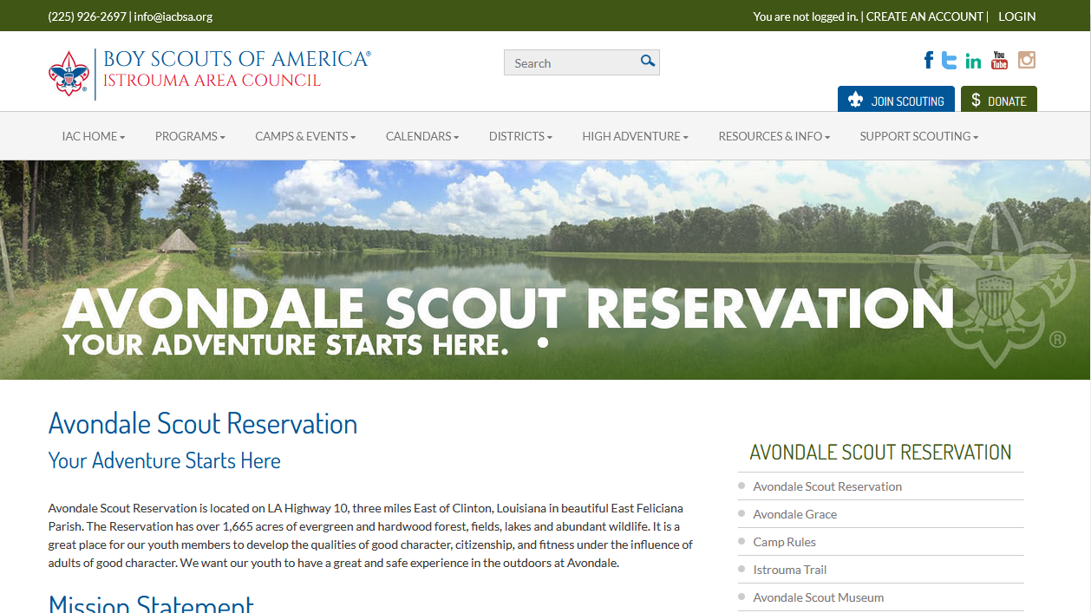
Information on Istrouma Council's Website
https://www.iacbsa.org/avondalesr

Slide 4
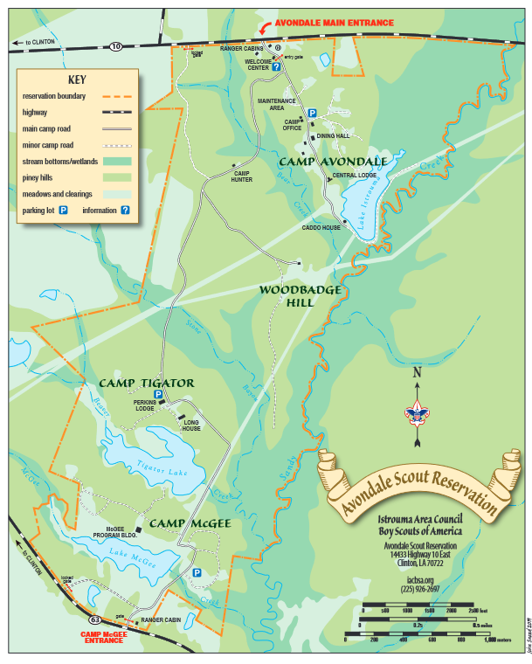

Slide 5
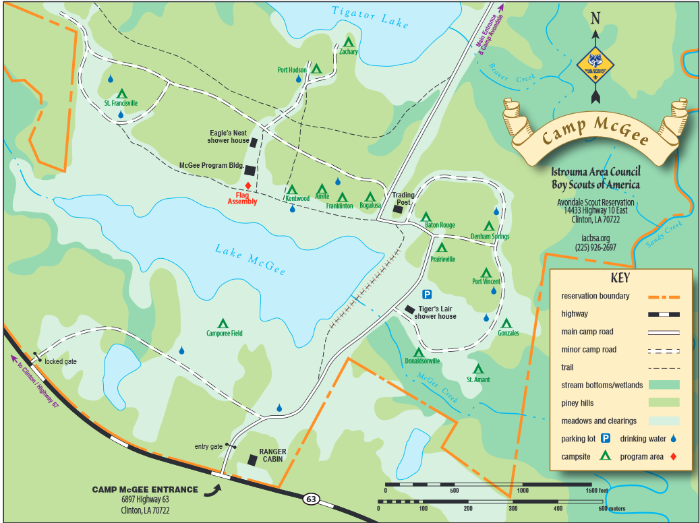

Slide 6
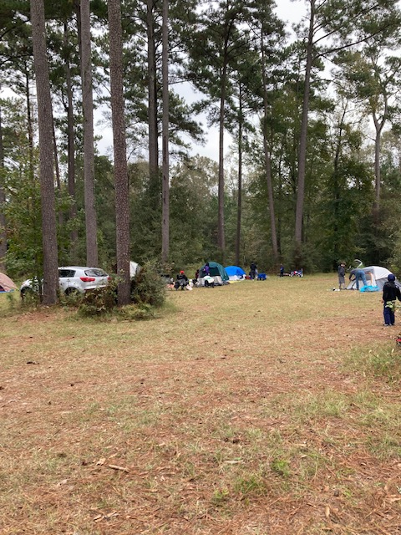
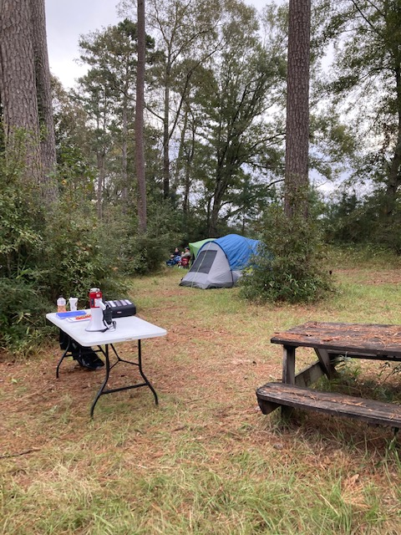
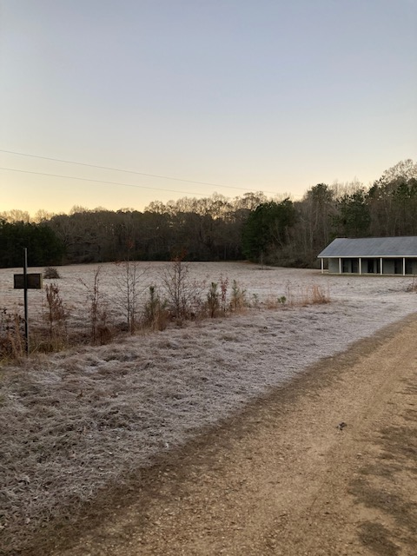
Primitive Camping Conditions
Kentwood Campsite Amite Campsite Bathhouse (not the one we will use but similar)

Slide 7
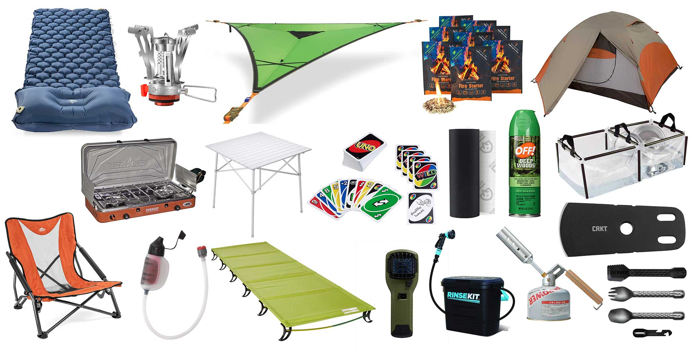
Camping gear

Slide 8
Tips (cold weather camping)
Air mattresses hold the temperature of the surrounding air. Below 55 degrees it’s like sleeping on an ice block. Consider cheap egg crate foam instead.
Set up and pack up your tent at home, in daylight, in good weather BEFORE coming on the campout.
Bring canteens and snacks like beef jerky and trail mix
Bring a plate, cup and fork for everyone in your family
Bring a folding chair or comfortable means of sitting on the ground.
Large tents do not heat up well, choose a tent that is big enough for everyone but small enough to retain nearby heat.
Bring more flashlights than you need and rain gear even if no rain predicted.
Bring fleece blankets and $2 foil emergency blankets
Don’t sleep in the clothes you wore all day, sweat rapidly cools at night and chills.
Get disposable hand warmers, put in socks at night, bring a knitted cap.
Put tomorrow’s clothes in sleeping bag with you, don’t leave shoes outside. (put muddy shoes in Walmart bag inside tent)
Use a belt to cinch off extra space at bottom of child’s sleeping bag, close to feet. Less to warm up.

Slide 9
Tips (warm weather camping)
Choose a shaded spot if possible. Maximize ventilation by leaving rain fly off during the day if it’s not raining.
Set up and pack up your tent at home, in daylight, in good weather BEFORE coming on the campout.
Face your tent’s door into the wind to bring in ventilation.
Keep tents zippered shut at all times to keep bugs out, use mesh doors to keep air flowing inside.
Bring canteens and snacks like beef jerky and trail mix
Bring a plate, cup and fork for everyone in your family
Bring a folding chair or comfortable means of sitting on the ground.
Bring more flashlights than you need and rain gear even if no rain predicted.
Stay hydrated, drink plenty of water through the day, dress appropriately in sweat wicking fabrics, wear sun protection, hats and sunscreen.
Don’t sleep in the clothes you wore all day, sweat rapidly cools at night and chills.
Use cooling accessories, battery powered fans, cooling towels

Slide 10
Proper Tent Site Selection
Look for level ground, the campsite slants down towards road
Don’t set up on an incline, or orient your head higher than feet
Look for good drainage
Be at lest 25 yards from water or fire
Don’t set up under large branches
Put a tarp underneath
Check for tent stakes still in ground when packing up.
Don’t block walking paths.

Slide 11
Facilities
The Bathhouses are permanent buildings.
We are within 100 yards of the Eagle’s Nest Bathhouse
Half toilet stalls with sinks, other half heated showers.
Be sure to clean up after yourself. Do not leave messes in the bathrooms.
Units are responsible for cleaning the bathrooms before leaving.
We are sharing with other units (Troops 1136 and 136) at Tigator.
Bathhouse has electric lights to find it in dark, but no outlets.

Slide 12
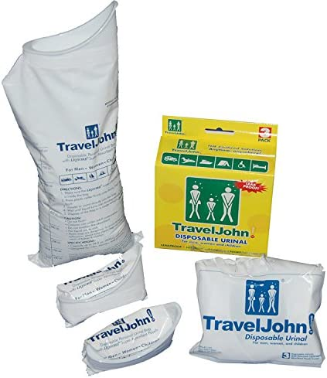
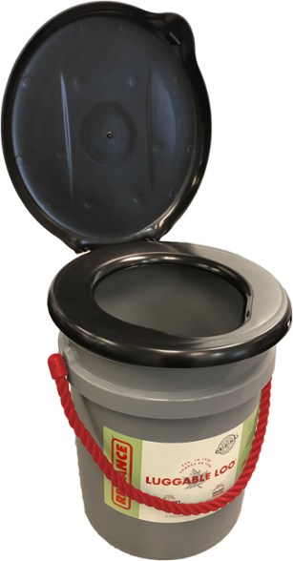
Late night bathroom suggestions
Garbage Bag with cat littler

Slide 13
Campout Schedule
Saturday
9:00-10:30 a.m. Arrival
10:30-12:30 Den Activities.
12:30-1:00 opening ceremony and lunch (each family provides its own lunch, sandwiches, etc.).
1:00- 3:30 p.m. Den Activities.
3:30- 4:15 to 4:30 p.m. Pack-wide Presentation by boy scout troop on outdoor cooking.
4:30pm – 5:00 pm Free time.
5:00 Dinner.
6:15 Pack-wide campfire and we start with a brief ceremony by handing out the Bobcat badges earned and our special, custom campout badge to all Scout attendees.
10 p.m. Lights Out
Sunday
Wake up for breakfast around 8-9 a.m.
Pack up and leave 9-10 a.m.

Slide 14
Points to remember
Every family should bring a lunch Saturday and every scout should have the 6 Essentials
There are water spigots around, bring canteen & bottles, and the fire should have water bucket nearby.
We will learn from the ranger when we get there how many fires we can have. We may only be allowed one for the Pack, so don’t start lighting a lot of small fires. All fires should be placed over existing fire sites or fire rings. Fires should never be left unattended.
No alcohol, drugs (unless prescription), firearms, tobacco or vaping products at all, and no knives allowed unless they are owned by an adult or a scout who has passed the Whittling Chip test. All scouts should carry their Whittling Chip card if they carry a knife.
Fishing is allowed in the lake, catch and release.
Do not leave a campsite without fully removing trash, tent stakes and any other items. Leave no trace! Bring trash bags, there is a dumpster by the gate.
Remember we are a coed unit, so no random urinating on the trees near the campsite. Please be away from the campsite or use the bathhouse.
Park vehicles only in designated areas. NOT IN CAMPSITES, NOT EVEN TO UNLOAD GEAR. NO PETS ALLOWED.
Anything you bring in you must bring out, dispose of trash in dumpster at north gate or bring it home.

Slide 15

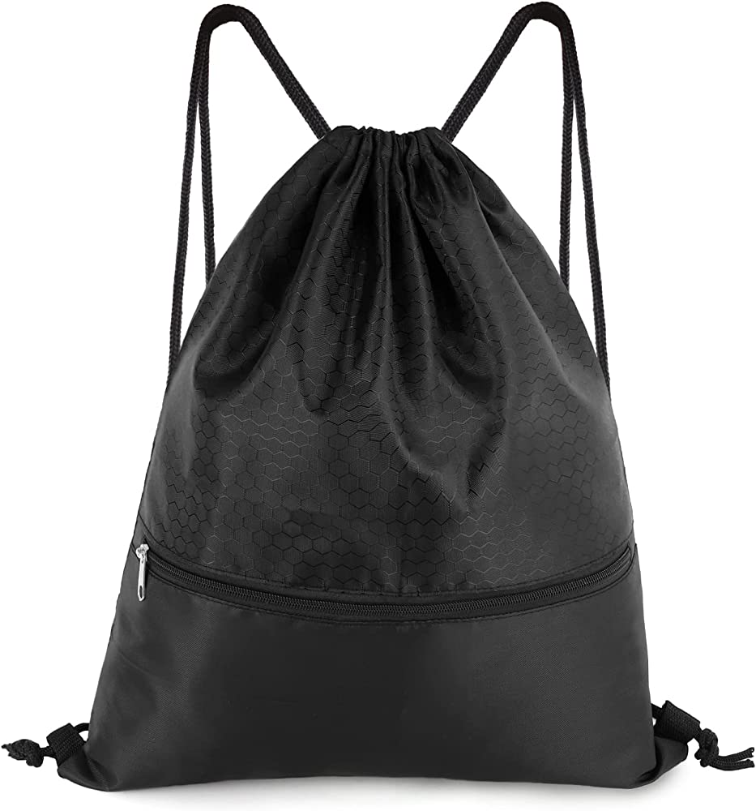

Slide 16







Rank activities
Tigers Let’s Camp
Wolves Let’s Camp
Lions Let’s Camp
Bears Let’s Camp
Webelos Let’s Camp
AOLs

Slide 17
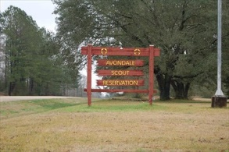
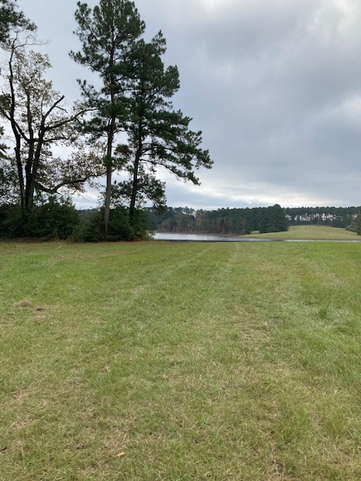
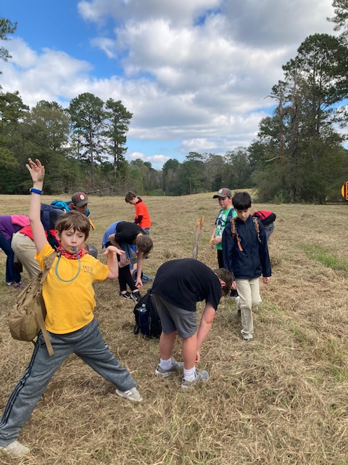
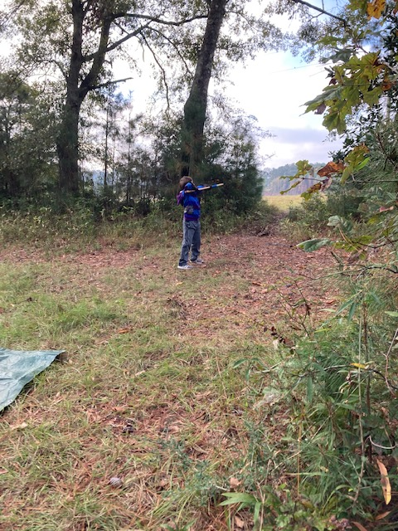

Slide 18
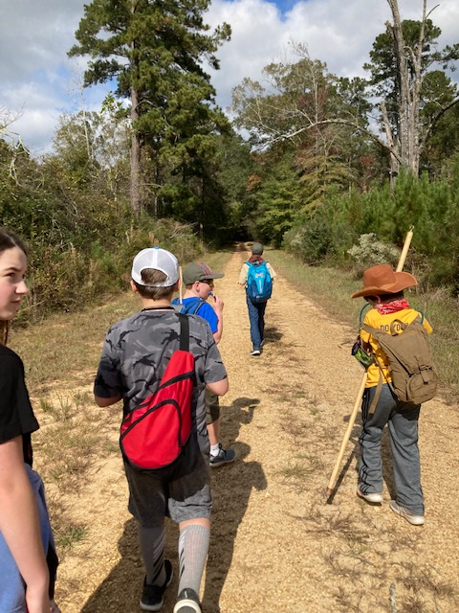
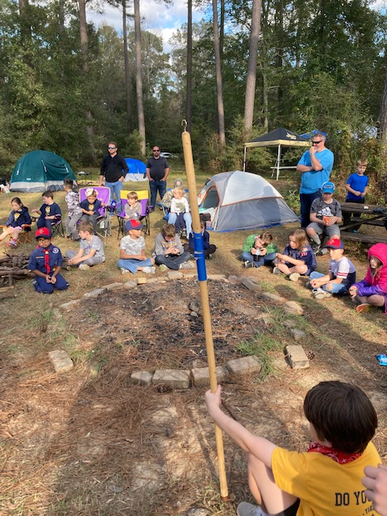
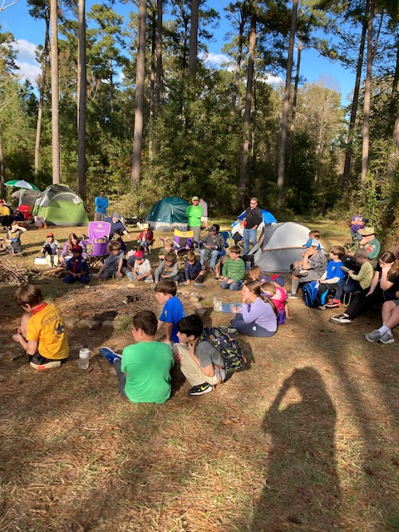

Slide 19
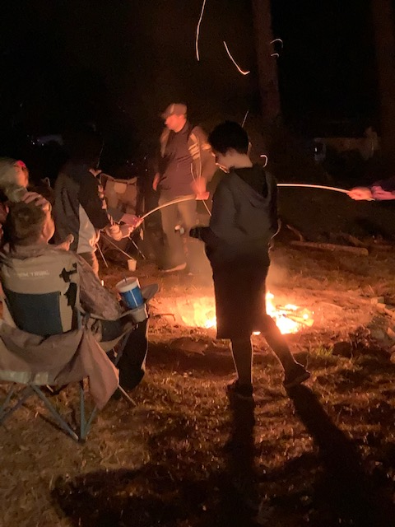
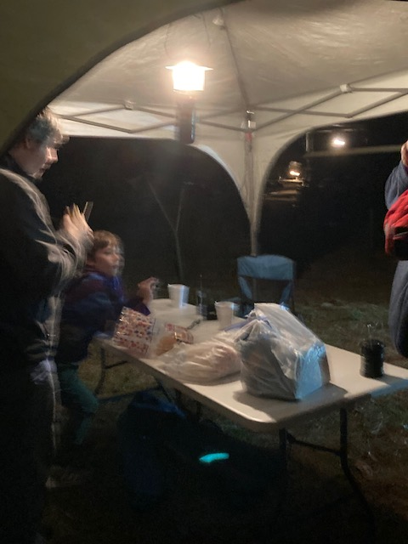

Slide 20
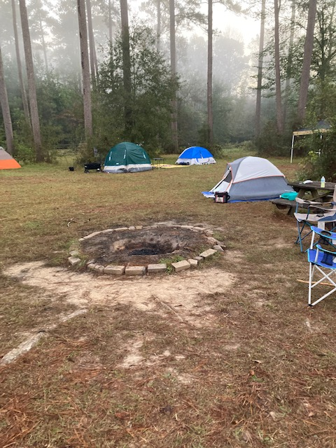
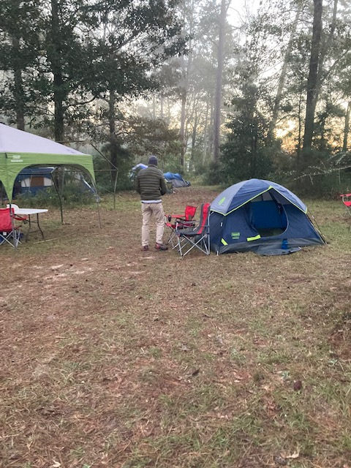

Slide 21
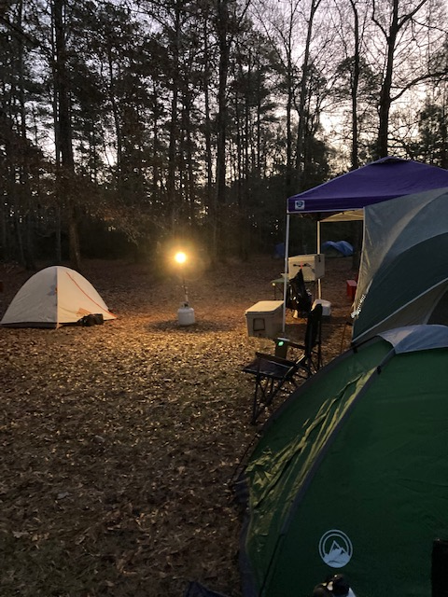

Slide 22
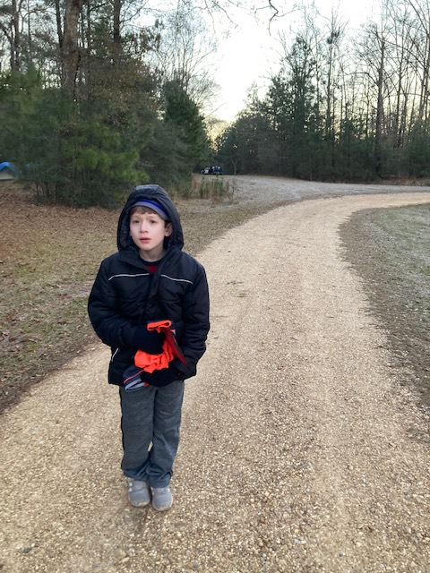
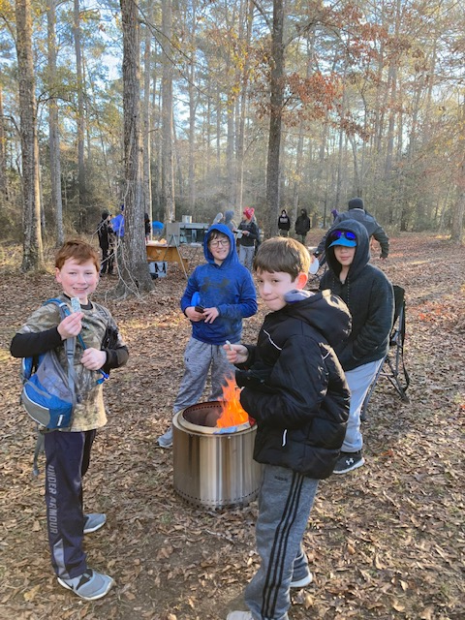

Slide 23
